Slide 1
Predicting Love Island Winners: Logistic Regression Analysis
Caroline Favelson

Slide 2
Research Question
What drives a couple’s probability of winning Love Island?

Slide 3
Love Island Rules Overview
5 girls and 5 boys (AKA the “OGs”) couple up based on initial impressions.
Being in a couple is crucial to staying in the villa.
New contestants, called “bombshells” enter the villa to shake up relationships and form new connections.
Periodic recouplings allow islanders to choose a new partner or stay with a current one. Islanders left single are at risk of elimination.
Islanders can be dumped from the villa by being single or by votes.
Islanders must balance staying loyal to their partner with exploring other connections.
The winner is chosen by public vote and is awarded £50,000.

Slide 4
Variables
Dependent Variable: Winning Status
Independent Variables:
at least 1 OG in the couple
Drama indicator
Recoupling frequency
Social media growth (log)
Day of coupling
Logistic regression in R -> figure out which variables (if any) have the greatest effect on who wins Love Island

Slide 5
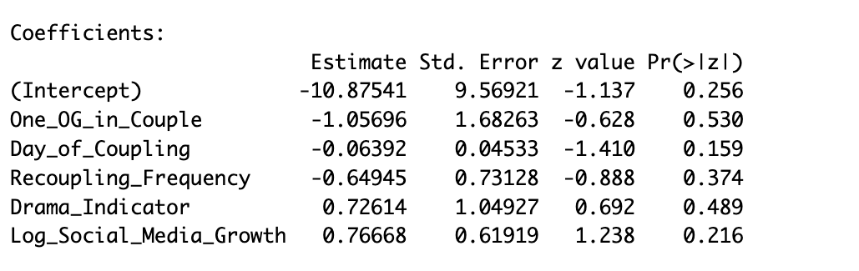
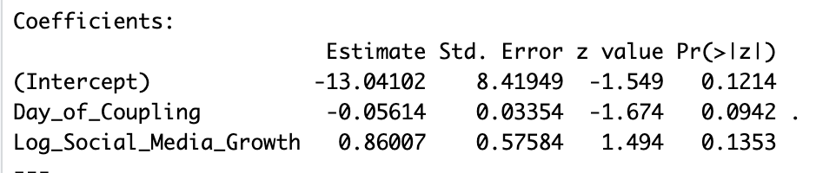
Results
All variables statistically insignificant
May be due to small data set and/or multicollinearity
Test VIF -> no multicollinearity
Backward Selection
Day of Coupling
Log Social Media Growth
Still insignificant, but will use in implications
Each additional day it takes a couple to form is associated with a 5.5% decrease in the odds of winning.
Each one unit increase in log-transformed media growth more than doubles winning odds

Slide 6
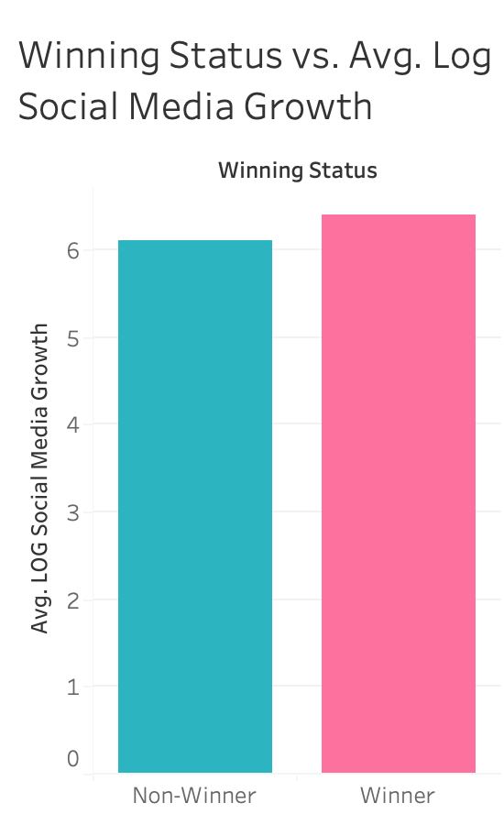
Winning Status vs. Social Media Growth
Winning couples have a slightly larger average log social media growth increase than non-winning couples.
If you are betting on who wins Love Island you want to compare all of the final couples combined social media growth and see who had the most.

Slide 7
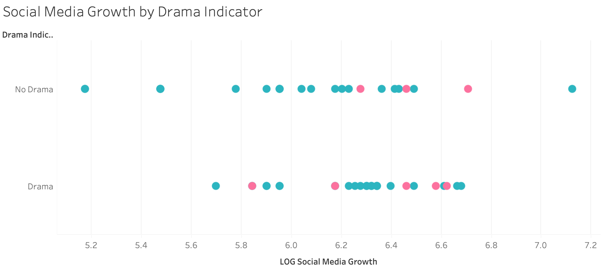
Social Media Growth by Drama Indicator
Social media growth is slightly more concentrated around *6.2 - 6.7 for couples with drama.
For couples with no drama, it is concentrated around 5.8 - 6.5.
This indicates that couples with more drama tend to have higher social media growth.
Note that more winners (pink) have drama and are centered around 6.5.
*Values shown are log transformed to account for skewed distribution.

Slide 8
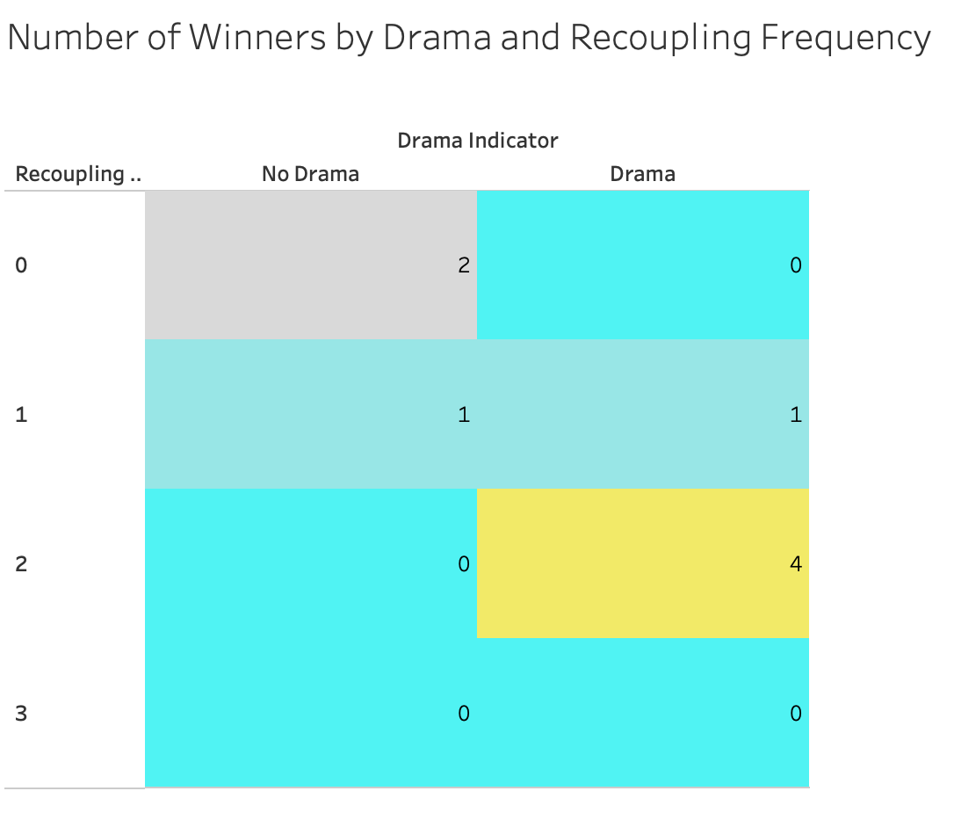
Number of Winners by Drama and Recoupling Frequency
Winning couples with no drama tended to recouple less.
Winning couples with drama tended to recouple 2 times.

Slide 9
Limitations
Small data set
Would be better to do every season of Love Island (include USA and other international seasons)
For this analysis I wanted to keep culture consistent
Season 1 social media outliers
Since Season 1 was the very first season, the show was not that popular yet, hence why social media growth is lower for all couples in the first season.
Possible omitted variable bias
Screen Time not available and difficult to obtain
Social media growth is very simplified
Lack of granularity for drama indicator

Slide 10
Islander’s Strategy: Do’s & Don't’s
Do’s
Don’ts
Do couple up as soon as you can
Do stay loyal while being desirable
Loyalty = popularity among viewers
Desirable = other islanders want you -> drama (which increases exposure to viewers) and maybe recoupling
Do get involved in drama to increase screen time
Don't create drama to increase screen time (better to be a victim or a hero than a villain)
Don't do things that can easily be misconstrued by producers
Don't ignore social conventions under the guise that you are in a “game” (Always be a girls girl!)

Slide 11
Implications
Day of Coupling and Social Media Growth seem to be the most telling factors of Love Island winners (ignoring insignificance)
Being in drama increases exposure to viewers. The more exposure an islander has, the more likely they are to gain popularity.
The more popular an islander is, the more votes they might get in the finale.
More drama -> more exposure -> more popularity -> higher chance of winning

Slide 12
The Love Story of the Couple YOU Should Bet On
Max entered the villa as an OG. From Day 1, he captivated the viewers with his stunning good looks and “golden retriever” personality. He coupled up with Ava, and the two seemed to get along, but no sparks were flying. On Day 2, a bombshell, Minnie, entered the villa. Minnie was beautiful and was a girl-boss in search of a guy that would worship her. Max and Minnie immediately hit it off and coupled up on Day 3. On Day 9, a bombshell named Ranger entered the villa and was given the privilege of stealing a girl from one of the guys. He was attractive, ambitious, and looking for a girl-boss woman to keep him in check. On Day 10 he steals Minnie, leaving Max single. Although Minnie and Ranger had much in common, but it seemed they were both too dominant to find a romantic connection. On Day 13 Minnie chose Max at the recoupling ceremony. Things were going great with them until Casa Amor on Day 28. Max felt like he had spent all of his time in the villa getting to know Minnie and this was his chance to meet some new girls. On Day 32, only 4 days later, he decides to couple up with Moda and bring her back to the villa. Minnie was heartbroken by this, as she had stayed single throughout Casa Amor. Once Max realized how badly he hurt Minnie at the recoupling ceremony, he spent the next few days trying to make it up to her. She was a tough nut to crack. At the recoupling ceremony on Day 35, Max chose to couple up with Minnie despite her still being mad at him. On Day 36, it was revealed that Max had told the other guys how much he missed Minnie while they were in Casa Amor, but they encouraged him to talk to other girls. Minnie became furious at the guys, whom she previously thought were her friends. She was particularly angry at Dev who was Max’s closest friend in the villa and introduced Max to Moda. Over the next few days, total chaos consumed the villa. Minnie was still upset with Max for choosing Moda over her, upset with Dev for being supportive of Max’s behavior, and angry at Moda for existing. Max was also upset with Dev since they both knew the real reason Max brought Moda back to the villa: Dev was interested in her, but the game did not allow for one guy to bring back two girls from Casa Amor. Max told Dev to tell Minnie. After many long conversations and rivers of tears, Minnie ended up forgiving Max. They came back stronger even after to the drama ensued.

Slide 13
Thank you!
If you have any questions, comments, or feedback, feel free to fill out this google form!
Feedback Form
Connect with me on Linkedin!

